Slide 1
Symphony of the Scriptures
Ephesians

Slide 2
Ephesians
61-63
A.D.
Our Position in Christ
Our Practice on Earth
Introduction (1:1-2)
Section:
1. What God has done for us (1)
Emphasis: Sovereignty
2. What Christ has done in us (2:1-10)
Emphasis: Grace
3. What Christ has done between us (2:11- 3:21) Emphasis: Reconciliation
Section:
Our new unity - oneness (4:1-16)
Our new walk (4:17-6:9)
3. Our new strength (6:10-20)
Conclusion (6:21=24)
Chapters
1-3
Chapters
4-6
Emphasis
Doctrinal: vertical relationship with God
Practical: Horizontal relationship w/others
Core
Phrases
He chose us in Him…(1:4)
Walk in a manner worthy of calling (4:1)
Declarations of heavenly truths
(God’s accomplishments)
Exhortations for earthly living
(Christians assignments)
Subjects
Theme
Christ and the church – the fulness of Christ (in Christ) --- “Walk” appropriately
Key
Verse
1:9-10; 1:13-14; 4:1-7
Notes:
Paul briefly visited Ephesus at the close of his second journey (Acts 18:18-21). He left Aquila and Priscilla there, and they taught Apollos (Acts 18:24-28). Paul came back on his third journey and remained in Ephesus three years (Acts 19:1-41; 20:31). Later, he leaves for Macedonia and calls for the elders to meet him in Miletus (Acts 29:17-38). Paul moves from correcting the many quarrels that were tearing apart the Corinthians. In Galatians he combated the legalism that was prevalent among them. In Ephesians, he seems to step aside from the conflicts and provides us with a vison of Christ’s majesty and His eternal purpose for the church. Paul wrote to the Ephesians while under house arrest in Rome awaiting trial before Caesar about 62 A.D. (see Acts 25:11-12; 28:30-31). He would also pen three other epistles during this period: Philippians, Colossians, and Philemon. Most of Paul’s writings were written over a span of 15 years. In AD 60, he arrived in Rome and was imprisoned later that year. For the next two years, Paul would live under house arrest in Rome (Acts 28:30-31). Paul’s audience is clear: “To the saints (those set apart - rcf) who are in Ephesus and are faithful in Christ Jesus” (1:1b). The phrase “in Christ” is a constant emphasis in Chapter 1 and the key thought is the gathering together of all things in Jesus Christ - all purposed by God. Chapters 1-3 show that Christ, through His death, burial, resurrection, and exaltation, has reconciled us to God when one answers the call through obedience. The result is a group of believers who are “one body” united with Christ as the head (1:20:23; 4:4). Chapters 4-6 instructs us how to live in light of our position as followers - “in Christ.” It tells us how to accomplish the work that God desires of a body, “a glorious church without spot or wrinkle.” One might say that in Ephesians Christ shows us what He has done for us (chapter 1), what He does in us (2:1-10), and what He has done between us (2:11-3:21). Paul tells us that our unity is dependent on submission: submission to God and to one another. Paul provides the panoply (full armor) of God that implies a call to battle for every follower that has seven armaments: truth, righteousness, peace with God, faith, salvation, the Spirit (God’s word), and prayer (6:10-18). The opponent or enemy is Satan who “schemes” to delude us (4:11:b). Paul proclaims that we are at war with Satan and his army. “Now to him who is able to do immeasurably more than all we ask or imagine, according to his power that is at work within us, 21 to him be glory in the church and in Christ Jesus throughout all generations, for ever and ever! Amen” (3:20-21).
Application
1. It is interesting to note that while the letter closes with Paul’s admiration of the Ephesians for their “love incorruptible” they “leave their first love” one generation later (Rev. 2:4). Christians beware! Has our love chilled?
2. The body is built up (edified) when each member does his part (Eph. 4:11, 16). Do you edify? 3. Being imitators of God (5:1) demands holiness. Holy is as Holy does. Is our behavior holy? 4. Submission is not just the role of a wife to a husband (5:22) - every Christian has the charge of submitting (5;21).
5. We are to “endeavor” or “Make every effort to keep the unity of the Spirit through the bond of peace” (4:3). We are to be “eager” for peaceful solutions in our dealing with one another. Do you promote peace?
Key thought: “See then that ye walk circumspectly, not as fools, but as wise, Redeeming the time, because the days are evil” (Eph. 5:15-16, KJV). We have sin in common. We have been redeemed. Can is be said of us that we are redeeming the time?

Slide 3
Period | History Covered | Scriptures | Years | Principal
Antediluvian | Creation to the Flood | Gen. 1-7 | 1656 | Adam
Postdiluvian | From the flood to call of Abraham | Gen. 8-!1 | 427 | Noah
Patriarchal | From the call of Abraham to Egyptian Bondage | Gen. 12-45 | 215 | Abraham
Egyptian Bondage | From Egyptian Bondage to the Exodus | Gen. 46-Ex. 11 | 215 | Joseph
Wilderness Wanderings | From Exodus to crossing of the Jordan | Ex. 12-Deut. 34 | 40 | Moses
Conquest of Canaan | From crossing of Jordan to Joshua’s death | Josh. 1-24 | 51 | Joshua
Judges | From Joshua to King Saul | Ju, Ruth, 1 Sa. 1-9 | 305 | Samuel
The United Kingdom | From origin of kingdom to its division | 1 Sa. 9-1 Ki. 11; 1 Chr. 10, 2 Chr. 9 | 120 | David
The Divided Kingdom | From the division to the fall of Israel | 1 Ki. 12-2 Ki. 20; 2 Chr. 10-32 | 253 | Elijah
Judah Alone | From fall of Israel to the fall of Judah | 2 Ki. 21-25; 2 Chr. 10-32 | 125 | Josiah
Babylonian Captivity | From the fall of Judah to the return | 2 Ki. 25-8- 21; Dan. 1-6; Ezekiel | 70 | Daniel, Ezekiel
Restoration of the Jews | From the return to end of OT history | Ezra, Nehemiah | 92 | Ezra
Between the Testaments | From end of OT to the beginning of the NT | None | 400 | Judas Maccabee
Life of Christ | From birth of Jesus to ascension | Mt-Jhn 21; Acts1 | 34 | Jesus
The Church | From ascension to death of Paul (96 AD approx.) | Acts 2-Revelation | 70 | Paul

Slide 4
Matthew
Mark
Luke
John
Acts
Romans
1 Corinthians
2 Corinthians
Galatians
Ephesians
Philippians
Colossians
1 Thessalonians
2 Thessalonians
1 Timothy
2 Timothy
Titus
Philemon
Hebrews
James
1 Peter
2 Peter
1 John
2 John
3 John
Jude
Revelation
CHRONOLOGICAL
James 50 AD
Mark 50 AD
1 Thessalonians 52 AD
2 Thessalonians 52 AD
1 Corinthians 57 AD
2 Corinthians 57 AD
Galatians 58 AD
Romans 58 AD
Matthew 58 AD
Luke 58 AD
Acts 62 AD
Philippians 62 AD
Philemon 62 AD
Colossians 62 AD
Ephesians 62 AD
1 Peter 65 AD
2 Peter 67 AD
Jude 67 AD
Titus 67 AD
1 Timothy 67 AD
2 Timothy 68 AD
Hebrews 69 AD
John (Gospel) 85 AD
1 John 85 AD
2 John 85 AD
3 John 85 AD
Revelation 95 AD
CANON
*From Hester, Heart of NT History

Slide 5
About the New Testament “Canon”
The list of books which are recognized as inspired and authoritative.
FIVE DIVISIONS
Gospels (4)
Matthew
Mark
Luke
John
Acts (1)
Book of History
Letters of Paul (13)
Thessalonians (2)
Corinthians (2)
Romans
Galatians
Philippians
Philemon
Ephesians
Colossians
Timothy (2)
Titus
General Letters (8)
James
1 & 2 Peter
1,2, 3 John
Jude
Hebrews
Apocalyptic (1)
Revelation

Slide 6
Approximate Chronology of Acts
Date
Chapter
Event
Letters Paul wrote
15:36-
18:22
SECOND MISSIONARY JOURNEY
Syria, Cilicia, Galatia, Troas, Philippi,
Thesss, Berea, Athens, Corinth, Ephesus
FROM CORINTH
50-54
AD 52 - 1 Thessalonians
AD 53 - 2 Thessalonians
18:23-
21:17
THIRD MISSIONARY JOURNEY
Ephesus, Macedonia, Achaia,
Corinth, Philippi, Troas, Miletus
FROM EPHESUS
54-58
AD 56- 1 Corinthians
FROM MACEDONIA
AD 57 - 2 Corinthians
FROM CORINTH
AD 57 - Romans
AD 57 - Galatians
58
21:18-23
Arrest in Jerusalem
58-60
24-26
Imprisonment in Caesarea
60-61
27-28:16
Voyage to Rome
61-63
28:17-31
Paul’s imprisonment in Rome
FROM ROME
AD 62 - Colossians
AD 62 - Ephesians
AD - 62 Philippians
AD 62 - Philemon
---The Book of Acts Ends Here---
FROM MACEDONIA
AD 66 - 1 Timothy
AD 66 - Titus
63-66
Paul’s release from prison
66-67
FROM ROME
Second imprisonment in Rome
AD 66 - Hebrews (?)
AD 67 - 2 Timothy
68
Paul’s Martyrdom
*Taken from Harkrider Workbook Commentary on Acts - Book 1, page 4-5

Slide 7
The Second Missionary Journey (Acts 15:36-18:22)
COMPANIONS Paul, Silas, Timothy, Luke
TIME: About 3 years (AD 50-53)
DISTANCE - 2800-3000 miles
I. PROVINCE: SYRIA
Antioch (15:35-41)
PROVINCE: CILICIA (15:41)
PROVINCE: GALATIA
A. Region: Lycaonia (14:6)
1. Derbe (16:1-5) 2. Lystra (16:1-5)
IV. PROVINCE: ASIA MINOR
A. Region: Phrygia (16:6)
B. Region: Mysia (16:7) 1. Troas (16:8-11)
PROVINCE: SAMO-THRACIA (16:11)
PROVINCE: MACEDONIA (16:9)
1. Neopolis (16:11)
2. Philippi (16:12-40)
3. Amphipolis (17:1)
4. Appalonia (17:1)
5. Thessalonica (17:1-9)
6 . Berea (17:10-17)
PROVINCE: ACHAIA (Greece)
1. Athens (17:15-34) 2. Corinth (18:1-17)
3. Cenchrea (18:18)
VIII. PROVINCE: ASIA MINOR 1. Ephesians (18:19-21) IX. PROVINCE: SYRIA
1. Caesarea (18:22) 2. Jerusalem (18:21-22) 3. Antioch (18:22)

Slide 8
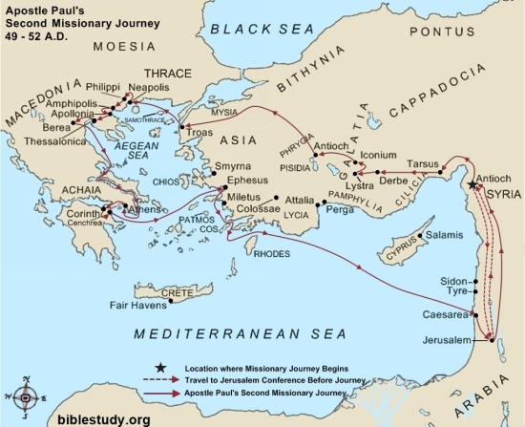
paul's missionary map
“And they came to Ephesus, and he left them there, but he himself went into the synagogue and reasoned with the Jews. 20 When they asked him to stay for a longer period, he declined. 21 But on taking leave of them (Priscilla and Aquila), he said, “I will return to you if God wills,” and he set sail from Ephesus.” (Acts 18:219-21)

Slide 9
The Third Missionary Journey (Acts 18:23-21:17)
COMPANIONS Paul-several men are named along the way: Timothy (19:22; 20:4; Eph. 19:22); Gaius (19:29; 20:4); Others from 20:4: Aristarchus, Sopater, Secundus, Tychicus; and Titus (2 Cor. 7:5-7).
TIME: About 4 ½ years (AD 53-58).
DISTANCE - 2800-3000 miles
I. PROVINCE: SYRIA
Antioch (18:22-23)
PROVINCE: GALATIA (18:23)
PROVINCE: ASIA MINOR
A. Region: Phrygia (14:23)
B. Region: Asia 1. Ephesus (19:1-41)
IV. PROVINCE: MACEDONIA (20:1-2)
A. Region: Philippi (20:6)
PROVINCE: ACHAIA (Greece) (20:2-3)
PROVINCE: MACEDONIA (20:3-6)
1. Philippi (20:6)
VII. PROVINCE: ASIA MINOR 1. Troas (20:6-12) 2. Assos (20:13-14)
ISLAND MITYLENE (20:14)
ISLAND CHIOS (20:15)
X. ISLAND SAMOS
1. Trogyllum (20:15)
PROVINCE: ASIA MINOR
1. Miletus (20:15-38)
ISLAND COOS (21:1)
ISLAND RHODES (21:1)
PROVINCE: ASIA MINOR
1. Patara (21:1)
XV. PROVINCE: SYRIA
A. Region: Phoenicia (21:2)
1. Tyre (21”3-7)
2. Ptolemais (21:7)
3. Caesarea (21:8-14)
4. Jerusalem (21:15-17)

Slide 10
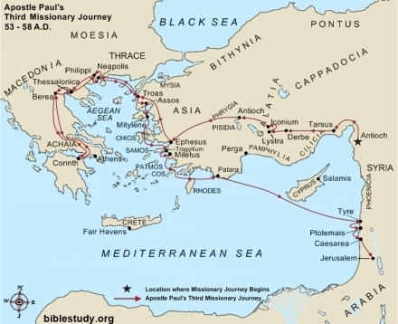
“And it happened that while Apollos was at Corinth, Paul passed through the inland country and came to Ephesus” (Acts 19:1)

Slide 11
“Ephesus was the most important city in Western Asia Minor (modern Turkey) in New Testament times. In fact, it was called ’the mother city’ of Asia. It had an estimated population of around 200,000 – 250,000, which was huge for those days, and it rivalled Antioch, Corinth, Alexandria and even Rome itself. Its wealth and importance came from its location. It was situated on an inland harbour linked by a canal to the River Cayster which flowed into the Aegean Sea; and it was at the crossroads of major trade routes. So it was an extremely important commercial centre-in fact, the largest trading centre in Asia Minor, attracting people from all over the world. Strabo, the Greek philosopher, historian and geographer, called it ‘the greatest emporium in the province of Asia Minor’. So when Paul chose to plant a church here, he was choosing the key city in the region, from which he planned for the new church to reach out.”
resources.takingground.org.uk/ephesus-in-the-first-century

Slide 12
Artemis
“In Greek and Roman mythology Artemis was the daughter of Zeus and the twin sister of Apollo….The Greek travel writer Pausanias said that she was the most worshipped goddess in private devotions in the Mediterranean world” (see Acts 19:28)
resources.takingground.org.uk/ephesus-in-the-first-century/

Slide 13
“But the temple wasn’t just about religion; it was also about business–big business! There was a guild of silversmiths who made little silver shrines and copies of the stone that fell from heaven. Clearly they made a good living out of it; because when Paul began to preach about Jesus and people started responding to the gospel, they were afraid that it might affect business and so stirred up a riot (Acts 19:23-41).
But Artemis affected more than the livelihood of a guild of silversmiths. She affected the whole of the city’s life. In fact, her temple served as the city’s main bank, and thousands of temple servants were entrusted with looking after the fortunes that people entrusted to them. Artemis’ image was also on their coins, and festivals and games held in her honour. So to challenge Artemis, like Paul did, was to challenge the whole social and economic order. But that is what the gospel is meant to do!” Ibid

Slide 14
Who wrote the book?
For a brief time at the end of his second missionary journey, and then for more than two years on his third missionary journey, Paul ministered to the church at Ephesus (Acts 18:18–21; 19:1–41). During his time in this city that housed the famous temple to the Greek goddess Artemis, Paul saw many converted and many others who opposed his preaching in the synagogues and homes. One prominent silversmith, Demetrius, who made implements for the worship of Artemis, found his business suffering greatly because people were converting to Christianity. The ensuing near-riot led Paul to leave the city, but only after the apostle had done much to stabilize and grow the Christian community there.

Slide 15
Where are we?
Paul wrote the letter to the Ephesians sometime in AD 61–63, around the same time he wrote Colossians and Philemon, as he sent all three letters by the hand of Tychicus, accompanied by Onesimus (Ephesians 6:21; Colossians 4:7–9; Philemon 1:10–12). It was during this time that Paul sat in Rome undergoing his first Roman imprisonment (Ephesians 3:1; 4:1), making Ephesians one of the four epistles commonly known as the Prison Epistles. The others are Philippians, Colossians, and Philemon.

Slide 16
Why is Ephesians so important?
Second Corinthians and Galatians abound with personal touches from Paul, either about his own life or that of the recipients. Ephesians, on the other hand, stands at the opposite end of the spectrum as one of Paul’s most formal letters. While Galatians offers instructions particularly important for those churches overrun with legalism, Ephesians deals with topics at the very core of what it means to be a Christian—both in faith and in practice—regardless of any particular problem in the community. It should be noted that it only takes a generation for a church to ”leave your first love” --- as it happened to the Ephesus church (compare Eph. 6:23; Rev. 2:4).

Slide 17
What's the point?
Our position in Christ: Paul spent the first three chapters of the letter discussing God’s purpose and plan by His gift of grace in the death and resurrection of Jesus Christ. The church is the result of a well executed plan that has folks answering the call and being adopted as sons and daughters of God. All people with this faith—Jews and Gentiles alike—were dead in their transgressions and sins but have been made alive because of the person and work of Jesus Christ.
Our practice on Earth: So after laying out profound theological truths in the first half of the book, Paul made his purpose clear in the next three chapters: he expected that followers would walk in accordance with their heavenly calling (4:1). As a disciple several practices should follow in our relationships with each other in the church, in the home, and in the world. When properly attired, the panoply of God will defeat every scheme of the evil one.

Slide 18
How do I apply this?
The book of Ephesians hits on a wide range of moral and ethical behaviors, designed to ensure believers are living up to our heavenly calling. As we continue in our faith from day to day, the temptation to get comfortable will always exist. However, Paul presented the gift of God in Christ and the benefits we receive so clearly that we cannot help but ask ourselves if our lives reflect that reality as they should.
How have you grown in your Christian life since you came to faith in Jesus Christ? The latter half of Ephesians makes clear that spiritual growth occurs primarily in community with others, iron sharpening iron (Proverbs 27:17). Your Christian “walk” (in other words, your daily life) is to be characterized by unity, holiness, love, wisdom, and perseverance in spiritual warfare.
Maturity yields benefits in believers’ moral lives, but it extends far beyond that as well. Increased maturity benefits the community at large, leading us as Christians to present a more consistent witness to the working of God in our lives as well as protecting us from the harmful divisions and quarrels that have plagued so many communities throughout history..

Slide 19
Brief Outline
God is the architect and fountainhead of all blessings (1:1-14)
The church is the fullness of Christ (1:15-23)
The church is the body of all saved by grace through faith (2:1-10)
The church is the one body of all reconciled Jews and Gentiles (2:11-22)
The church is according to God’s eternal purpose (Ch. 3)
We must endeavor to keep the unity of the Spirit (4:1-16)
The character and behavior of a Christian (4:17-5:21)
The Christian’s attitude in different social relationships (5:22-6:9)
Put on the whole armor of God (6:10-24)
Harkrider, Bible Commentary Series, Acts, Book 2, page 78

Slide 20
A Comparison of Parallel Texts
Subject
Ephesians
Colossians
Salutation
Holy, Blameless
Redemption
All are reconciled in Christ
Position of Christ
Christ is the Head, of Body
Spiritually dead in sin
Made alive in Christ
Reconciliation of Jews/Gentiles
End of the Law of Moses
The mystery Paul preached
Walk in meekness
One Body
Christ nourishes His Body
Put off old man; put on new
God’s wrath against sin
Be filled with Spirit/Word
Sing & make melody/with grace
Redeem the time
Responsibility of wives
Responsibility of husbands
Responsibility of children
Responsibility of fathers
Responsibility of servants
Responsibility of masters
Paul’s request for prayers
Work for Tychicus
1:1-2
1:4
1:7
1:10
1:20-21
1:22-23
2:1
2:5-6
2:11-13
2:14-16
3:1-7
4:2-3
4:4
4:15-16
4:22-32
5:3-6
5:18-20
5:19
5:15-16
5:22-24
5:25-33
6:1-3
6:4
6:5-8
6:9
6:18-20
6:21-24
1:1-2
1:22
1:14
1:20
3:1
1:18, 24
2:13
2:12-13
1:20-22; 2:11
2:14-17
1:25-29
3:12-15
3:15
2:19
3:5-15
3:5-8
3:16-17
3:16
4:5
3:18
3:19
3:20
3:21
3:22-25
4:1
4:2-4
4:7-8

Slide 21
Church
Fulness of Him Eph. 1:22-23
Christ is the Savior
Eph. 5:23
Ro. 6:3-4
Place of Reconciliation Eph. 2:16
Gal. 3:26-27
One Body Eph. 4:6; 1:22-25

Slide 22
The Best Life
Home
Eph. 5:22-23
Eph. 6:1-4
Wives --- “Freedom in Submission” (1 Pe. 3:1-6)
Husbands --- “Loving Leadership” (1 Pe. 3:7)
Children --- ”Heritage of the Lord” (Ps. 127:3-5)
Business
Eph. 6:5-9
Employees--- Works as “unto the Lord” (Col. 3:22-25)
Employers --- Knows the Lord is Master (Col. 3:23-25)
Victory over the devil (1 Pe. 5:8-9; Ja. 4:7)
Peace (forgiveness) (Eph. 1:7; Mt. 11:2830)
Joy (purpose to life) (1 Pe. 1:13-16; 2:11)
Spiritual
Eph. 6:10-18
“Godliness with contentment is great gain” (1 Ti. 6:6-8)

Slide 23
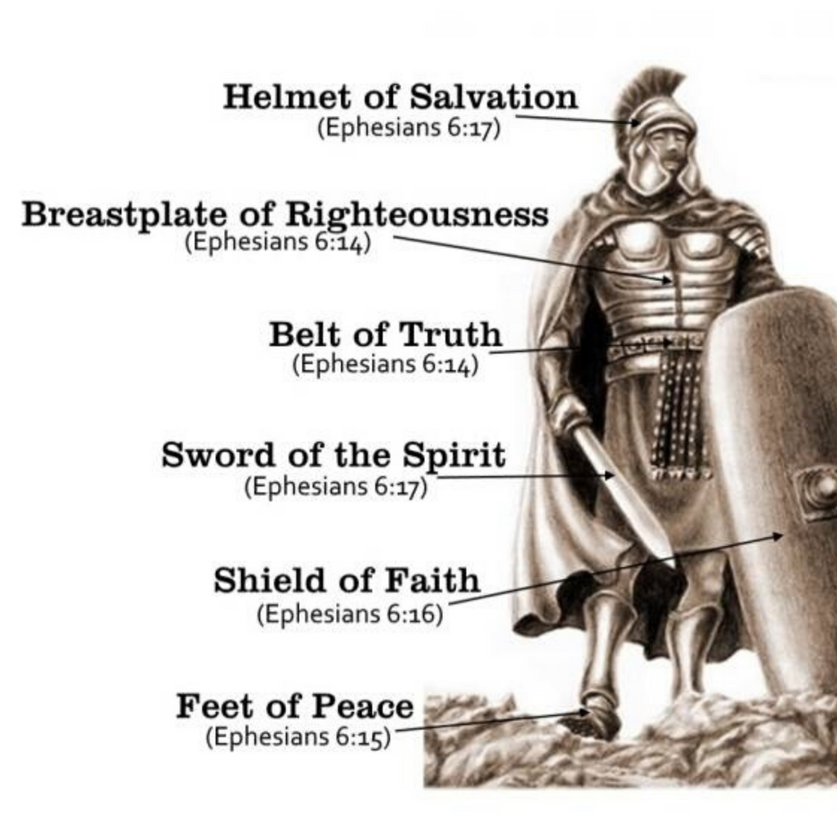
“Finally, my brethren, be strong in the Lord, and in the power of his might. 11 Put on the whole armour of God, that ye may be able to stand against the wiles of the devil.12 For we wrestle not against flesh and blood, but against principalities, against powers, against the rulers of the darkness of this world, against spiritual wickedness in high places.13 Wherefore take unto you the whole armour of God, that ye may be able to withstand in the evil day, and having done all, to stand.14 Stand therefore, having your loins girt about with truth, and having on the breastplate of righteousness;15 And your feet shod with the preparation of the gospel of peace;16 Above all, taking the shield of faith, wherewith ye shall be able to quench all the fiery darts of the wicked.17 And take the helmet of salvation, and the sword of the Spirit, which is the word of God:18 Praying always with all prayer and supplication in the Spirit, and watching thereunto with all perseverance and supplication for all saints; 19 And for me, that utterance may be given unto me, that I may open my mouth boldly, to make known the mystery of the gospel,20 For which I am an ambassador in bonds: that therein I may speak boldly, as I ought to speak” (Eph. 6:10-20, KJV)
THE PANOPLY OF GOD

